Slide 1
Microservices 1

Slide 2
Introduction
Microservices Architecture
Design considerations
Design strategies
Microservices testing
The Twelve Factor methodology
Steps to build the microservices
Exercise

Slide 3
Introduction

Slide 4
Netflix streaming: The birth of popularized microservices
Whether or not you've heard about microservices, I'm sure you've heard of Netflix. Thanks to Netflix's success in creating and releasing software for managing cloud infrastructure
Around 2009, driven completely by APIs and riding the initial wave of what we would come to know as microservices — Netflix completely redefined its application development and operations models.
Notes:
I'm even willing to bet that you've heard of Netflix Open Source Software (NOSS)

Slide 5
Microservices Architecture

Slide 6
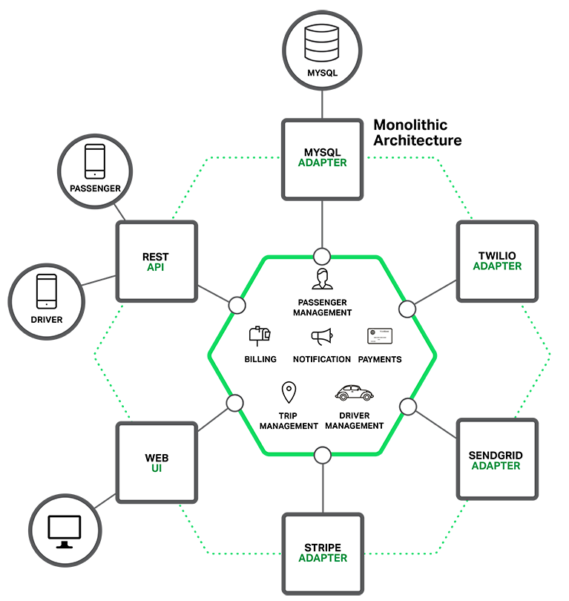
Why Consider microservices ?
Application is packaged and deployed as a monolith
After few years, a simple application will grown into a monstrous monolith for serval enhancements
Difficult for a developer to fully understand
Difficult to scale when different modules have resources requirement
All modules are running within a same process. A bug in one module can potentially bring down the entire process.

Slide 7
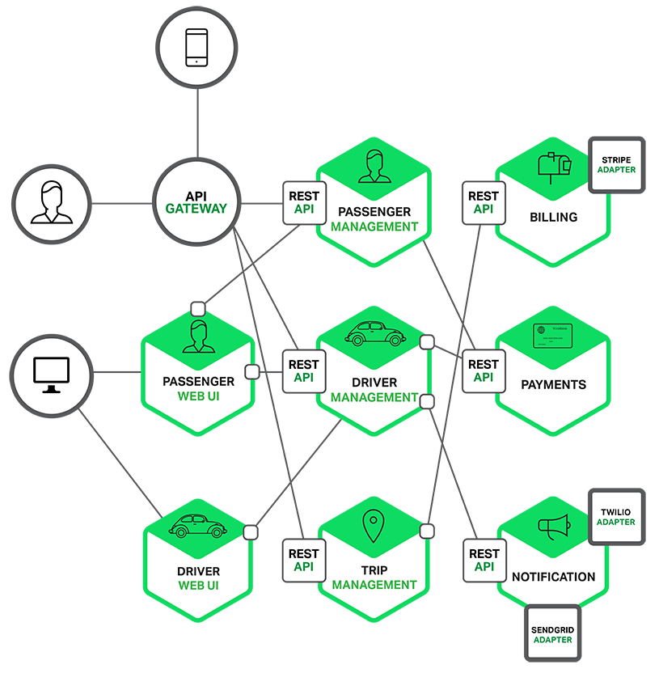
Microservices Architecture
Each functional area is implemented as a standalone service
One big web application is split into simpler web applications
Each backend service exposes a REST API and most services consume APIs provided by other
Expose rest API to mobile apps through API gateway. API Gateway is responsible for task such as load balancing, caching, access control.
6

Slide 8
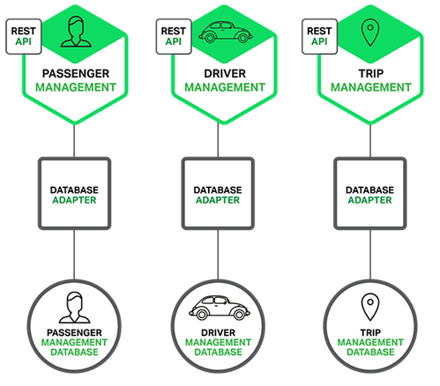
Microservices Architecture
Easy service can running on its own container. In order to be highly available and easy to scale up
Developer can understand the service easily

Slide 9
What exactly are microservices ?
Small and Focused
based on the business needs and focused on accomplishing a small unit of work
Loosely Coupled
independently deployed, scaled, updated, and redeployed
Language Neutral
developed or implemented using different programming languages, databases, hardware and software environment
Bounded Context
treated like a separate application or a product with well defined interfaces and business capability

Slide 10
Benefits of using microservice
Benefits of Utilizing Microservices
Lowered Learning Curve
Scale Bottlenecks
Quicker User Acceptance Testing
Quick To Market Changes
Business Alignment

Slide 11
The Drawbacks of Microservices
The term “Microservices”. Some developers who advocate for building extremely fine-grained 10-100 line of code services (i.e. Nanoservices)
Need to implement an inter-process communication mechanism based on messaging or RPC. Must also write code to handle partial failure since the destination of a request might be slow or unavailable
You need to update multiple databases owned by different services for a single request
Deploying a microservices-based application is also much more complex.

Slide 12
What is the difference between Microservice and API
API
API
API
Microservices can be used to expose one or more APIs
APIs are interfaces
Microservice A
Microservice B
Microservice C
Not all microservices components expose APIs
Microservices are components

Slide 13
Design considerations

Slide 14

API Design
https://hackernoon.com/restful-api-designing-guidelines-the-best-practices-60e1d954e7c9

Slide 15
Using HTTP Methods for RESTful Services
POST
used to create a new entity, but it can also be used to update an entity
GET
used to read (or retrieve) a representation of a resource
PUT
update an existing entry
DELETE
delete an entry; however, the resource does not have to be removed immediately. It could be an asynchronous or long-running request

Slide 16
HTTP status codes
Status codes indicate the result of the HTTP request.
1XX - informational
2XX - success
3XX - redirection
4XX - client error
5XX - server error

Slide 17
API path naming convention
Verbs are bad
Nouns are good
Plurals are better
For complex variations, put them after “?”
e.g. /dogs?color=brown&state=running&location=park

Slide 18
We only need two URLs
The first one is for a collection
e.g. /dogs
The second is for an element
e.g. /dogs/1234
Resource | POST create | GET read | PUT update | DELETE delete
/dogs | create a new dog | list dogs | bulk update dogs | delete all dogs
/dogs/foo | error | show Foo | if exists, update Foo; if not, error | delete Foo

Slide 19
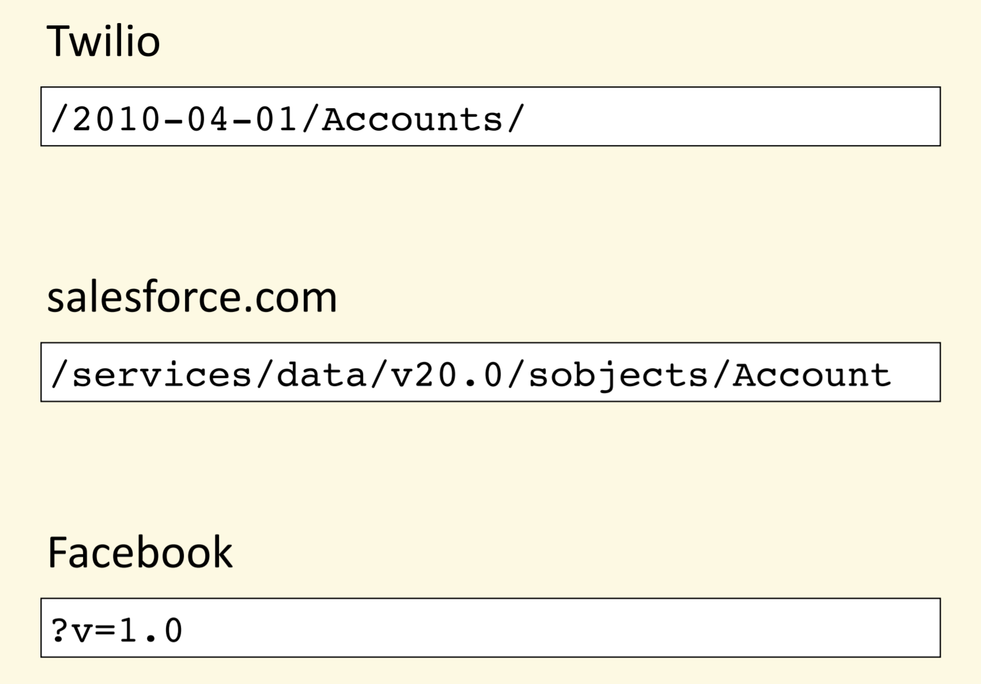
What about versioning?

Slide 20
Service versioning
Three different types of changes that are important for Service Versioning:
Major release
Functional change
Not backward compatible
Minor release
New capability
New optional service request patterns
Backward compatible
Point release
Bug fix
Performance enhancement
Backward compatible

Slide 21
Notes on using version number
Each release gets assigned a version number (e.g. v1.0.1)
When a client makes a request for a certain service, forwards the request to a version of the service which is compatible with the version of the client
Make sure all services are always version
Never use default or latest versions

Slide 22
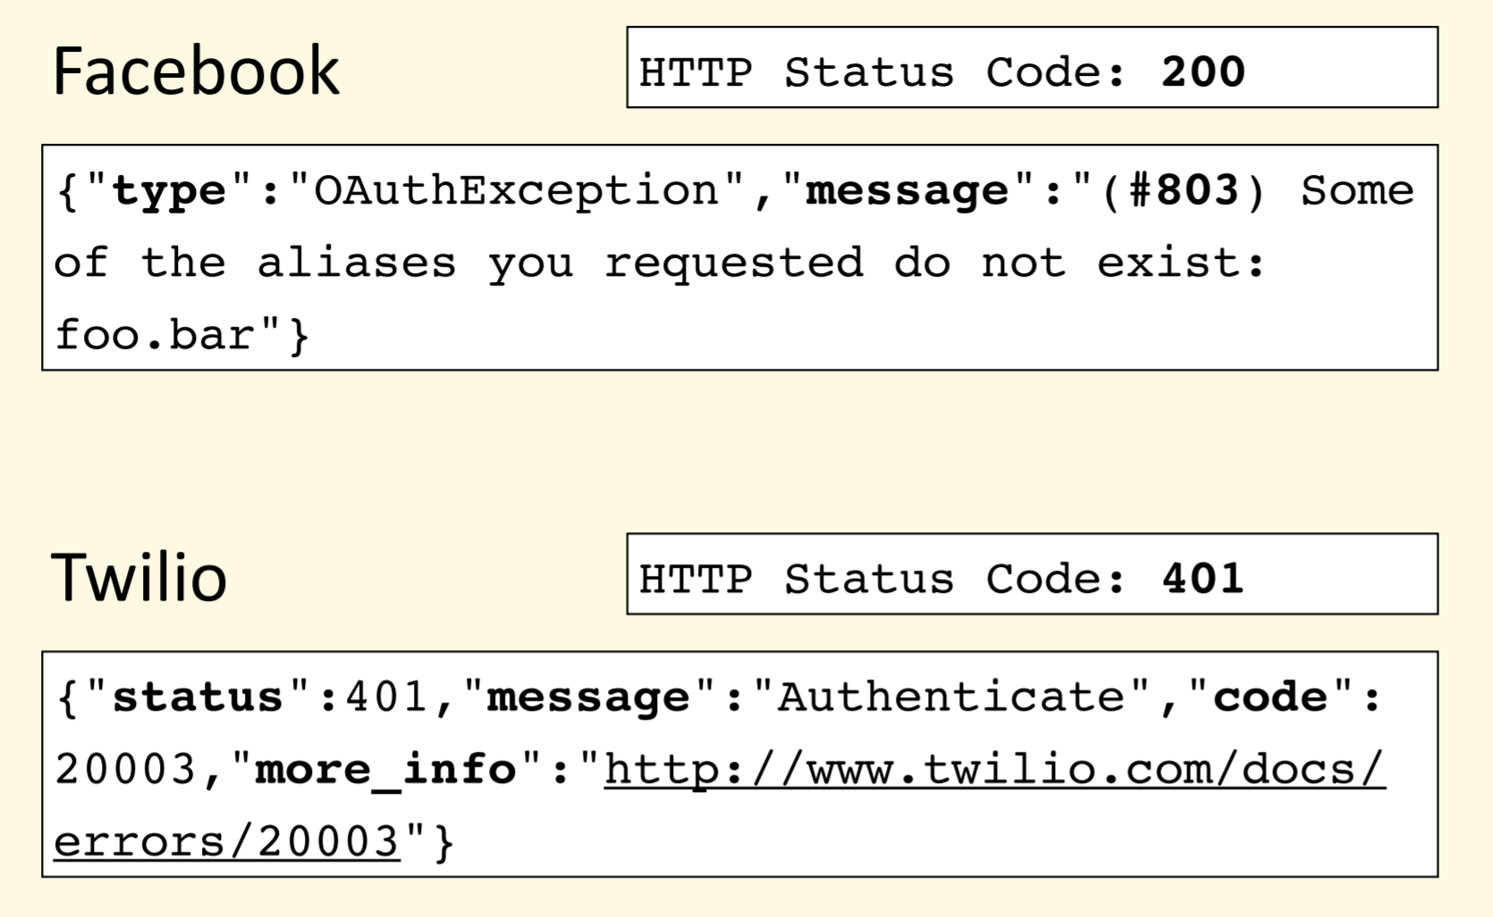
What about error?

Slide 23
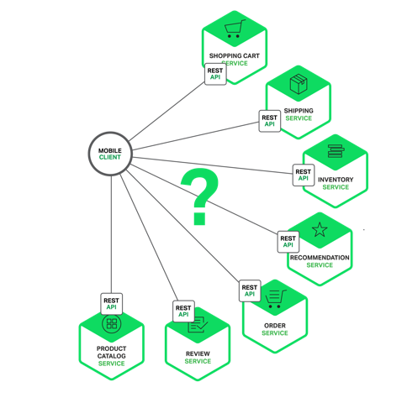
Using an API gateway - 1
Connect microservices directly
inefficient over the public Internet and would definitely be impractical over a mobile network
makes the client code much more complex
difficult to refactor the microservices

Slide 24
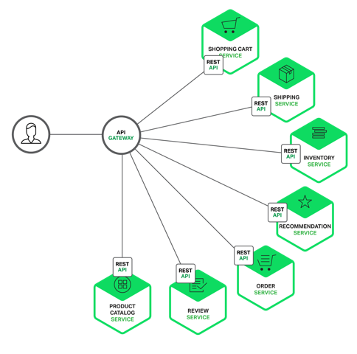
Using an api gateway - 2
Use API gateway
responsible for request routing, composition, and protocol translation
encapsulates the internal system architecture
provides an API that is tailored to each client
might have other responsibilities such as authentication, monitoring, load balancing, etc.

Slide 25
Design strategies

Slide 26

Design strategies

Slide 27
Event Driven
A microservice publishes an event when something notable happens, such as when it updates a business entity.
Other microservices subscribe to those events.
When a microservice receives an event it can update its own business entities, which might lead to more events being published.
You can use events to implement business transactions that span multiple services.
A transaction consists of a series of steps. Each step consists of a microservice updating a business entity and publishing an event that triggers the next step.

Slide 28
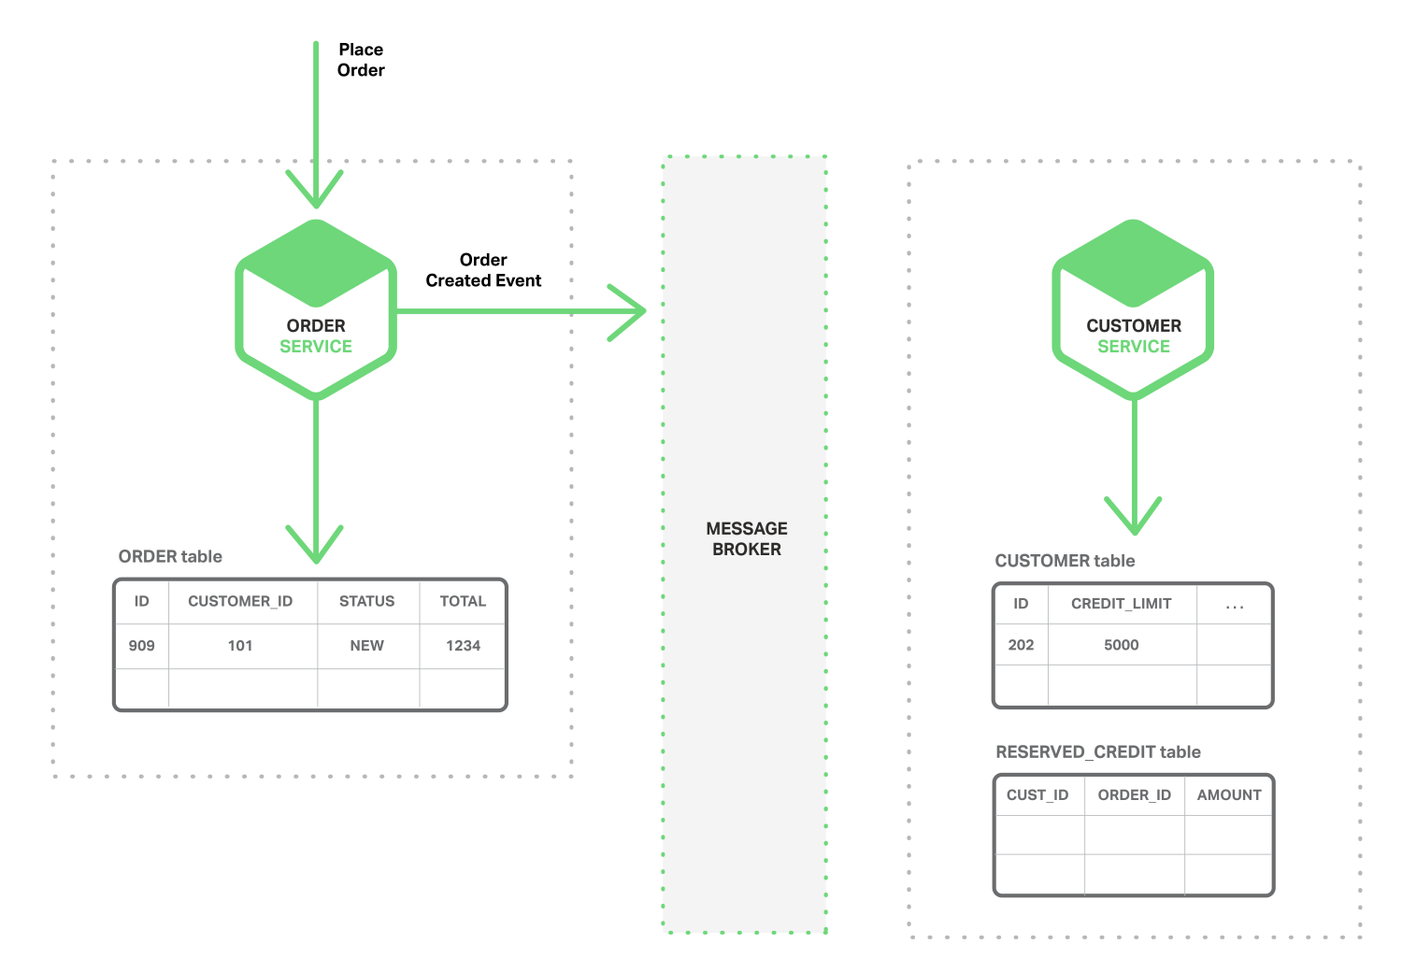
Event Driven architecture - 1
The Order Service creates an Order record with status NEW
Then publishes an Order Created event.

Slide 29
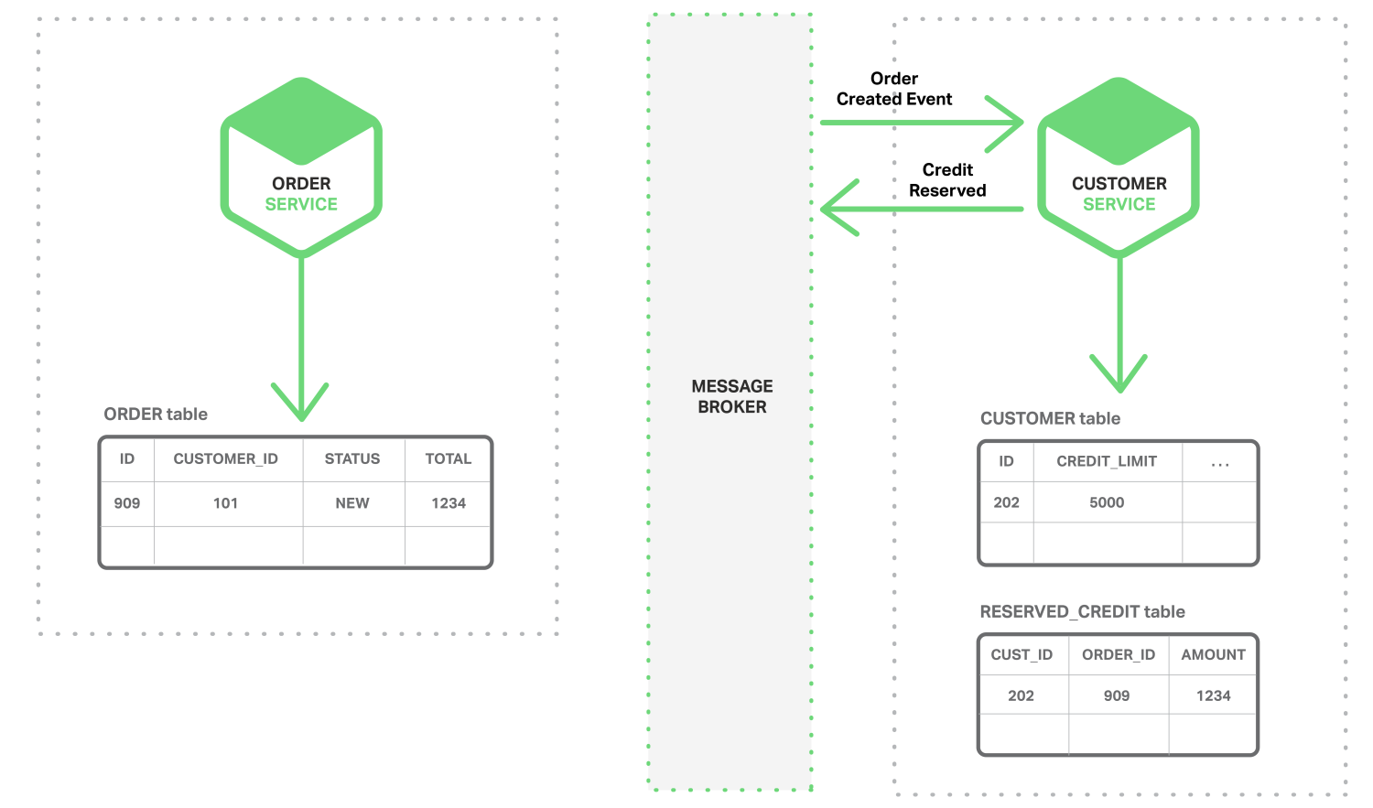
Event Driven architecture - 2
The Customer Service consumes the Order Created event
It reserves credit for the order
Then publishes a Credit Reserved event.

Slide 30
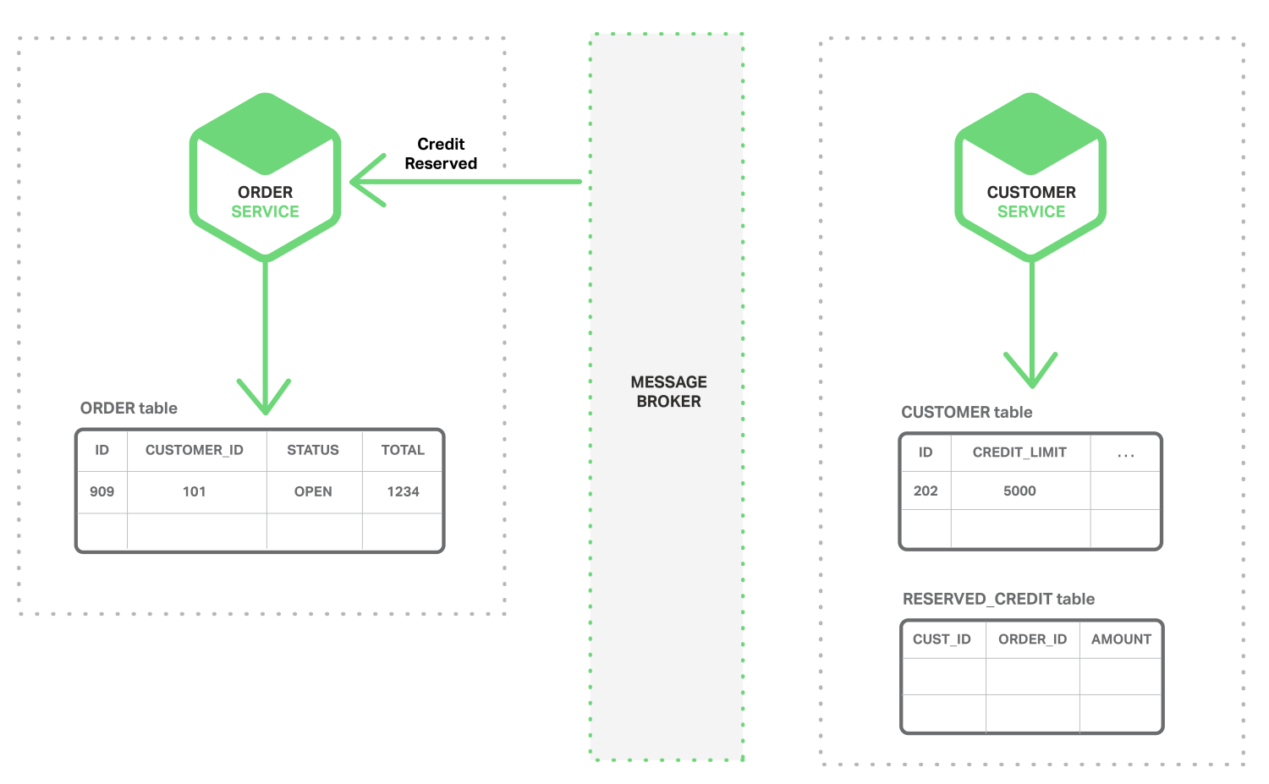
Event Driven architecture - 3
The Order Service consumes the Credit Reserved event
Then changes the status of the order to OPEN.

Slide 31
Benefits and drawbacks
Benefits
Loose coupling and extensibility
Provide eventual consistency
Enables an application to maintain materialized views
Drawbacks
Programming model is more complex
Applications must deal with inconsistent data. That is because changes made by in‑flight transactions are visible.
Subscribers must detect and ignore duplicate events.

Slide 32
Distributed data management
A monolithic application typically has a single relational database. A key benefit of using a relational database is that your application can use ACID transactions, which provide some important guarantees:
Atomicity – Changes are made atomically
Consistency – The state of the database is always consistent
Isolation – Even though transactions are executed concurrently it appears they are executed serially
Durability – Once a transaction has committed it is not undone

Slide 33
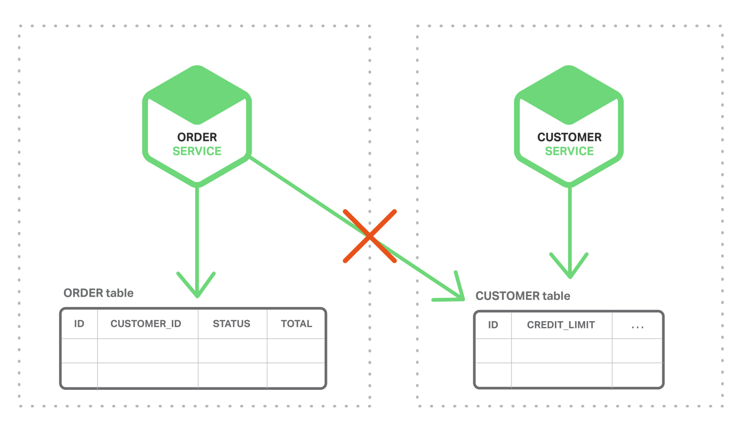
Problem of distributed data management in microservices
Each service has it’s own data and only be accessed via its API to ensure loosely coupled and independently of one another
Different microservices often use different kinds of database. Some may use NoSQL and some can use relational databases

Slide 34
Question
How to implement transactions and maintain consistency across multiple services ?

Slide 35
One of the solutions - Saga
A saga is a sequence of local transactions
Each local transaction updates its own database
Then publishes a message or event to trigger the next local transaction
If a local transaction succeeds, the saga executes a commit transaction
If a local transaction fails, the saga executes a rollback transaction

Slide 36
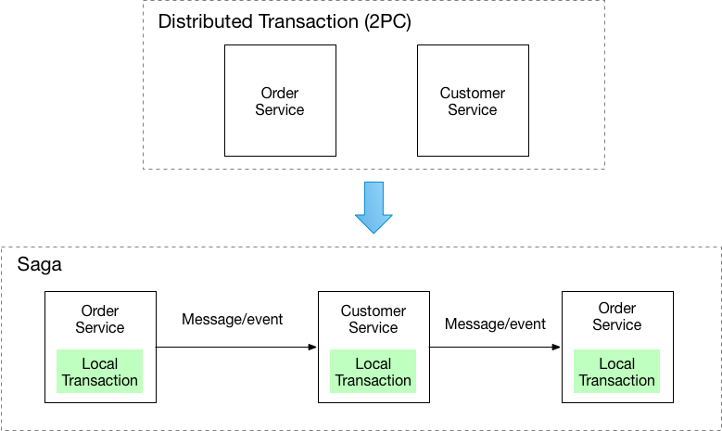
The Saga pattern illustration
Notes:
Two-Phase Commit (2PC)
Phase 1 - Each server that needs to commit data writes its data records to the log. If a server is unsuccessful, it responds with a failure message. If successful, the server replies with an OK message.
Phase 2 - This phase begins after all participants respond OK. Then, the coordinator sends a signal to each server with commit instructions. After committing, each writes the commit as part of its log record for reference and sends the coordinator a message that its commit has been successfully implemented. If a server fails, the coordinator sends instructions to all servers to roll back the transaction. After the servers roll back, each sends feedback that this has been completed.

Slide 37
Advantages and Disadvantages
The main benefit of the Saga Pattern is that it helps maintain data consistency across multiple services without tight coupling. This is an extremely important aspect for a microservices architecture.
The main disadvantage of the Saga Pattern is the apparent complexity from a programming point of view.
The other challenge is that compensating transactions also have to be designed to make Sagas work.

Slide 38
Microservices testing

Slide 39
Objectives
Three basic objectives to achieve while conducting microservices testing:
Code should do what it should be doing
Provide fast, reliable and accurate feedback
Make overall maintenance easier
Notes:
If you’re new to the microservices world, let me tell you, achieving all three of these becomes an art.
Since microservices architecture relies more on over-the-wire (remote) dependencies and less on in-process components, your testing strategy and test environments need to adapt to these changes.

Slide 40
Testing strategies
Why do you need a special strategy to test microservices?
The most common problem to deal with
Have a lot of integrations with other microservices
Reside within one’s organization as well as from the outside world (3rd party integrations)
Require a high amount of collaboration among different teams/squads
Single purpose services and are deployed independently & regularly

Slide 41
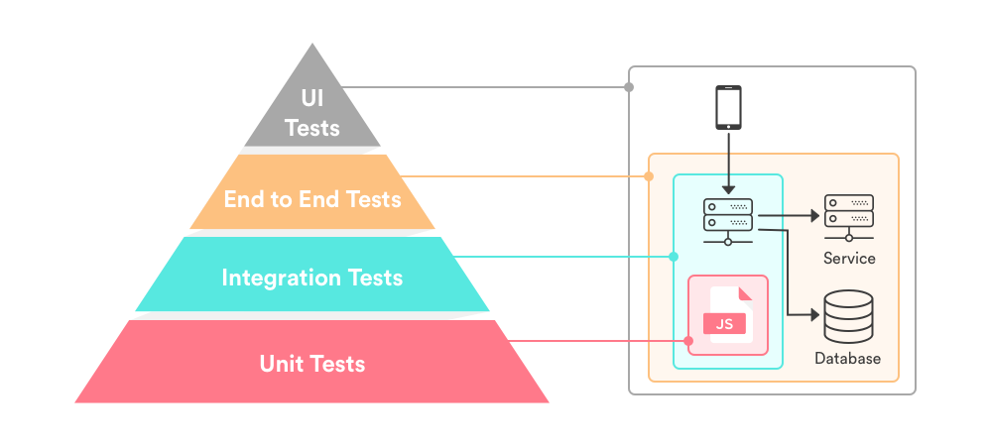
Testing strategies illustration
https://www.simform.com/microservice-testing-strategies/

Slide 42
Unit Testing for Microservices
At the bottom of the pyramid with comparatively larger test suites in size
Microservices are the smallest unit of business logic
These services then communicate with each other over a network
Therefore Unit testing is all the more important in this context to validate each business logic
Notes:
Do not get confused between unit testing and functional testing. They are a way different beast.
The purpose of unit testing is to isolate the smallest testable parts of an API and verify that they function properly in isolation.
The prime objective of Functional testing is to check the functionalities of the system.

Slide 43
Integration testing for Microservices
Integration testing verifies the communication path and interactions between the components to detect interface defects.
verify that microservices collaborate as intended to achieve some larger piece of business logic
test the communication path through a subsystem to check for any incorrect assumptions each microservices has about how to interact with its peers
understand each request what services would touch before it circles back to the user with a response
Notes:
DON’T confused over the integration tests for acceptance tests on the external components.
The only goal is to aim for basic success and error paths through the integration module.
e.g. incorrect SSL handling and missing HTTP headers, at the protocol level.
e.g. the persistence integration test ensures that each component and protocol client must respond as an external dependency in case of timeouts and partial failures.

Slide 44
Component Testing in Microservices
Component tests should be implemented within each microservice’s code repository
In a typical application, we will have a number of microservices
Test a single microservice in isolation, we need to mock the other microservices
Isolating the microservices in this way using test doubles avoids any complex behavior they exert on execution.
When you are ensuring the interfacing of different microservices, is it the same in the testing environment as well?
Notes:
Test Double is a generic term for any case where you replace a production object for testing purposes. (i.e. fake, mock, stub, etc.)
Point 5 (Interfacing issue) - To overcome this challenge, implementing a schema-based interface that both microservices incorporate into their interface implementation, providing a single source of truth when it comes to cross-microservices interactions.

Slide 45
End-to-End Testing in Microservices
Test scenarios concentrating on the major work flows and user journeys
Overall system is accurately working as well as the network infrastructure (load balancers, firewall, and more) is correctly configured
Treat the system as a black box while performing end to end tests
Verify the system as a whole meets business goals irrespective of the component architecture in use
Test the correctness of message passing between the services
Include UI test

Slide 46
The Twelve Factor methodology

Slide 47
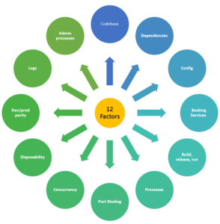
The Twelve Factor

Slide 48
The 12 Factor - 1
I. Codebase
One codebase tracked in revision control, many deploys
II. Dependencies
Explicitly declare and isolate dependencies
III. Config
Store config in the environment
IV. Backing Service
Treat backing services as attached resources
V. Build, release, run
Strictly separate build and run stages
VI. Processes
Execute the app as one or more stateless processes

Slide 49
The 12 Factor - 2
VII. Port Binding
Export services via port binding
VIII. Concurrency
Scale out via the process model
IX. Disposability
Maximize robustness with fast startup and graceful shutdown
X. Dev/prod parity
Keep development, staging, and production as similar as possible
XI. Logs
Treat logs as event streams
XII. Admin process
Run admin/management tasks as one-off processes

Slide 50
Steps to build the microservices

Slide 51
1 – Design first, code later
Before implementation, you should have the following considerations:
Rapid releases
giving you rapid releases of any frequency you choose e.g. several times a day, weekly or monthly
Adopt an Agile mindset
a certain level of maturity towards Agile working practices, e.g. a strong automated testing culture, a DevOps culture ideally with both Continuous Integration (CI) and Continuous Delivery (CD) in place
Enforce backwards compatibility
the API needs to be carefully thought out for ease of use, versioned and backwards compatibility maintained strictly

Slide 52
1 – Design first, code later
Use a whiteboard, not a keyboard
Define the overall application functionality
Then identify the individual services required
Example
In an e-commerce application, one important task might be “order product”
There are a lot of functions to support that task, such as checking inventory, accepting credit/debit cards, obtaining shipping addresses, calculating shipping cost, etc.
Need to identity each lower-level function so you can capture them in a service
Note: don’t expect this process to be finished in a single day. Also, you'll need to expose people from all across the organization to it so that you can include their viewpoints and requirements.

Slide 53
1 – Design first, code later
How to decompose business to services
One of the ways to define services corresponding to business capabilities. A business capability is something a business does in order to provide value to its end users
Identifying business capabilities and corresponding services requires a high level understanding of the business
For example, the business capabilities for an online shopping application might include the following:
Product Catalog Management
Inventory Management
Order Management
Delivery Management
Once the business capabilities have been identified, the required services can be built corresponding to each of these identified business capabilities.

Slide 54
2 – Contract first
Contract First is about making your intent clear across team members and external teams
By using a tool like Swagger (OpenAPI), we can define our programming API clearly at the beginning
The contract tells the consumer what the request and response communication is expected to be.
Once the contract is in place, the service provider can work on providing a service that adheres to the contract.
The service consumer can work on developing an application to consume it.
We can also update the “contract” before we implement changes to the code

Slide 55
2 – Contract first
Advantages
Teams Can Develop in Parallel
the service provider and service consumer teams are clear about the communication approach and details. Hence, development can happen at the same time.
Teams Know What to Expect
if cross team testing is not possible due to different paces of development, stub software can be used to mock the other's behavior, all based on the contract.
Cross-Platform Compatible
the service provider and service consumer can use different technologies.
Enables Reuse of Schemas
The schemas are well defined, if parts of services are repeated across other services, then the corresponding schemas can be reused as well.

Slide 56
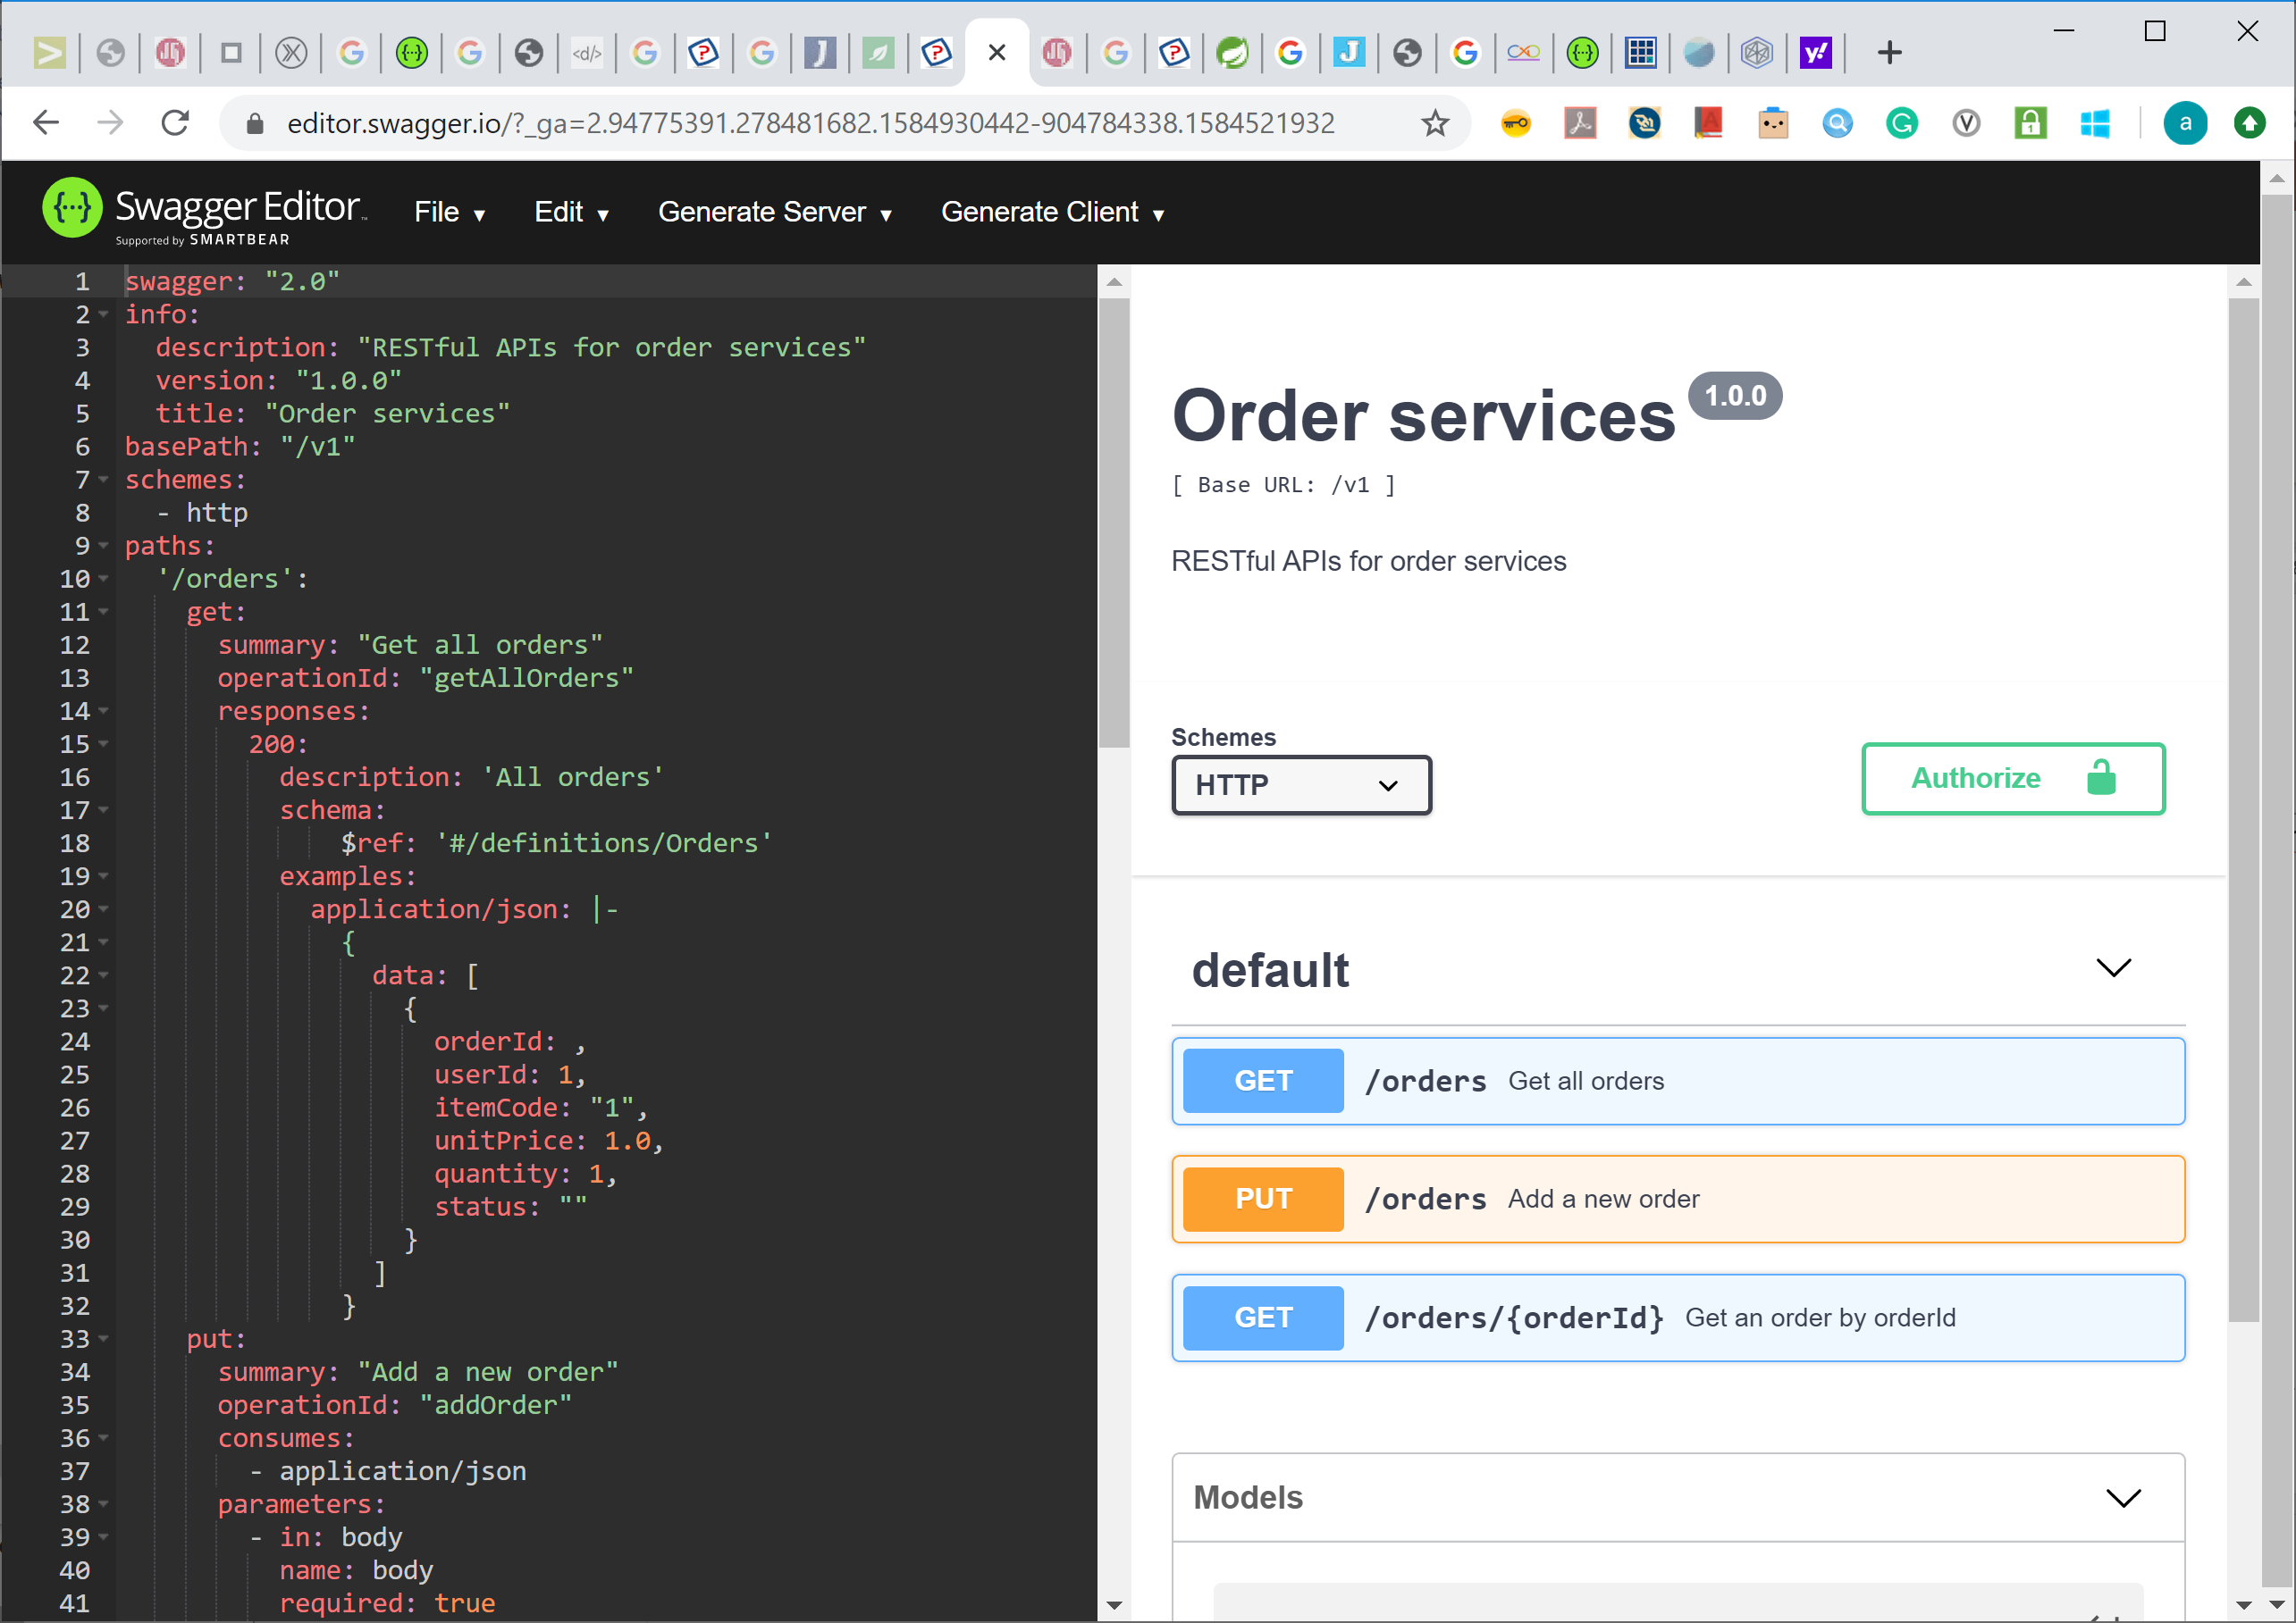
3 – Using Swagger
Swagger Editor
The Swagger Editor is great for quickly getting started with the Swagger (OpenAPI) Specification
Here’s the URL:
https://swagger.io/tools/swagger-editor/
For OpenAPI Specification:
https://github.com/OAI/OpenAPI-Specification/blob/master/versions/2.0.md
Use this tool to design and validate the “contract”

Slide 57
3 – Using Swagger
Swagger codegen
In earlier step, we have saved the specification in yaml format. To further generate source code, this swagger.yaml file will be the source of input of Swagger CodeGen tool
To download the tool:
https://github.com/swagger-api/swagger-codegen
Example, command to generate code
java -jar swagger-codegen-cli-2.3.1.jar generate \
-i swagger.yaml \
--api-package com.howtodoinjava.example.employee.api \
--model-package com.howtodoinjava.example.employee.model \
--group-id com.howtodoinjava.example \
--artifact-id spring-swagger-codegen-employee \
-l spring \
-o spring-swagger-codegen-employee

Slide 58
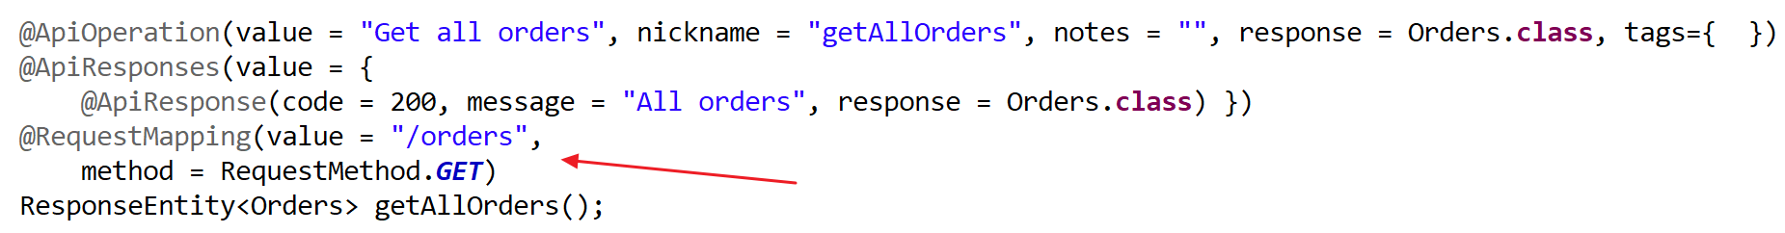
4 – Implementation
After generating the code, we can now implement the APIs
Snippet of the generated code
In the above example, we need to implement the business logic of getAllOrders

Slide 59
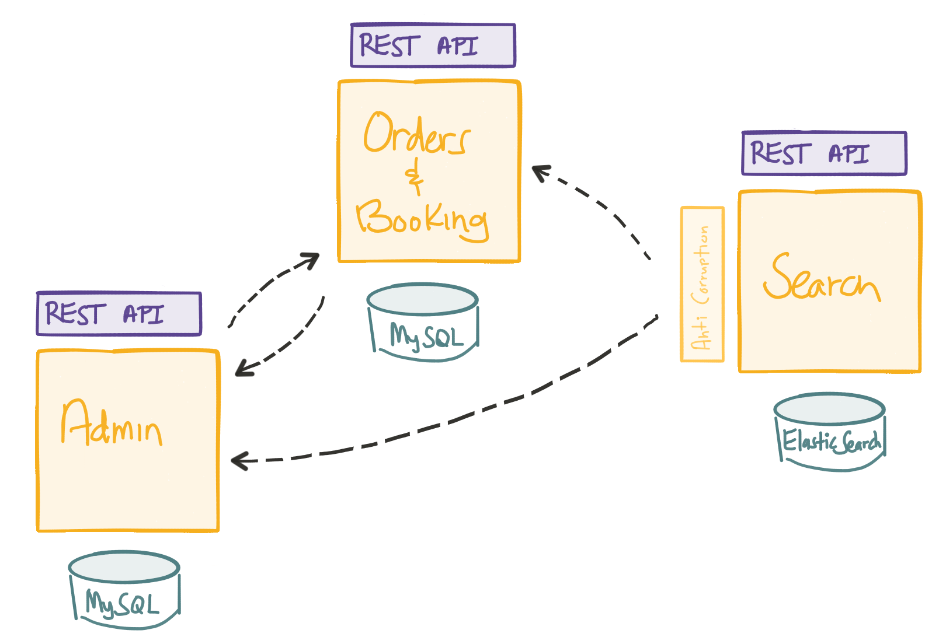
4 – Implementation
Database considerations
Keep each microservice’s persistent data private to that service
Accessible only via its API.
A service’s transactions only involve its database.

Slide 60
4 – Implementation
Security Considerations
More Services = More Complexity
“A database per service”, or something like that
now you have more databases to manage and secure
More complexity in deployments
Segmentation and isolation
Multi-cloud? Like some stuff in AWS, some in Azure?
Identity management and access control
Data / message integrity
Rapid rate of change, deprecation cycle

Slide 61
4 – Implementation
Security Considerations – Best practices
Use OAuth for user identity and access control
The overwhelming majority of applications are going to need to perform some level of access control and authorization handling
Don’t Show Sensitive Data As Plain Text
what you need to do is identify what your most sensitive services are, and apply a number of different layers of security to them
Don’t write your own crypto code
Use automatic security updates
High testing coverage here is more essential than ever. Every time a part of your system is updated, you want to make sure you catch any issue early enough and in as much detail as possible
Notes:
OAuth2 isn't perfect, but it's a widely adopted standard. The advantage of using it is that you can rely on libraries and platforms that will greatly accelerate your development phase.

Slide 62
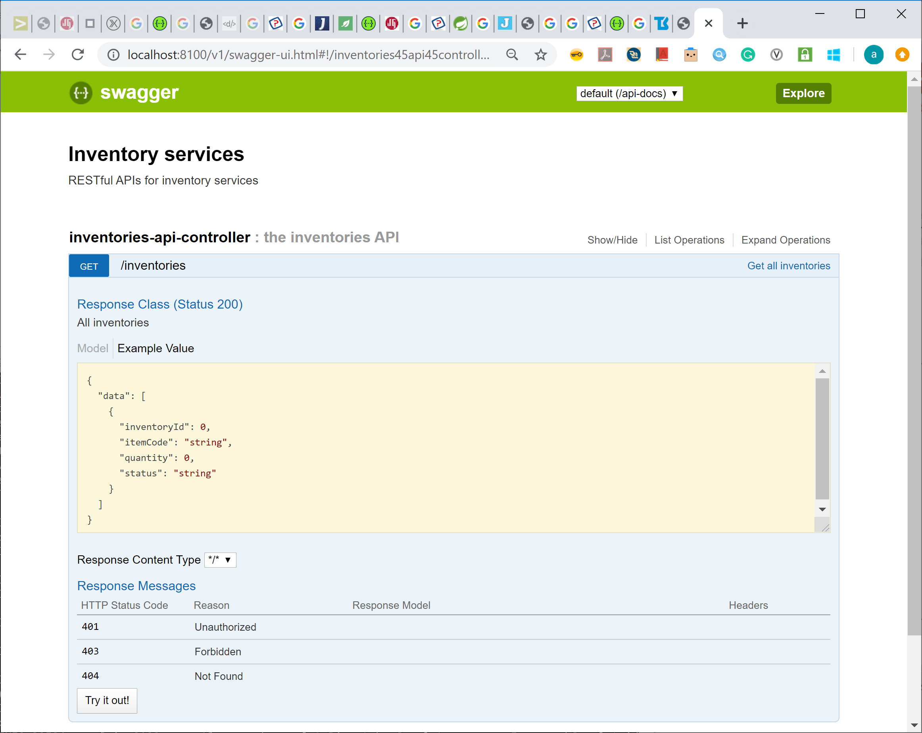
5 – Testing
Swagger UI
Use Swagger UI to test the API functionalities

Slide 63
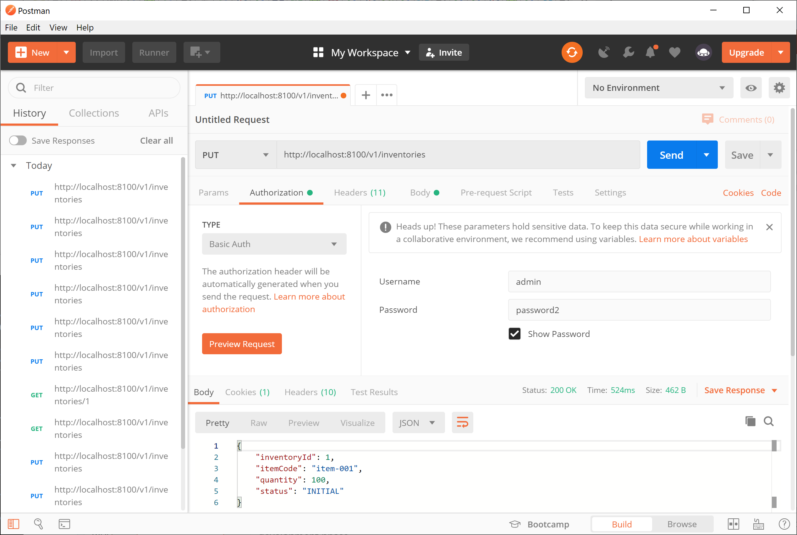
5 – Testing
Postman
Use Postman to test the API functionalities

Slide 64
5 – Testing
Types of tests
Unit Tests
Unit tests are the tests that target small units of code, preferably in isolation.
The objective here is to validate the behavior of the smallest testable piece of code without worrying about the rest of the codebase
Integration Tests
Units of code need to work together and often with external services like databases, message brokers, or web services.
target the behavior of an application while integrating with external dependencies.
UI Tests
A software we develop is often consumed through UI interfaces
UI tests target the behavior of these interfaces
these tests can be conducted in an end-to-end manner, or user interfaces can also be tested in isolation.

Slide 65
5 – Testing
Test Framework
The most popular choice here in Java is JUnit, which has a next-generation release known as JUnit5. Other popular choices in this area include TestNG, which offers some differentiated features compared to JUnit5. However, for most applications, both of these are suitable choices.
The objective of an integration test is to test an application behavior with real integrations. However, we may not want to hit an actual database or message broker for tests. Mockito is an excellent framework to provision mocks for real objects in Java.

Slide 66
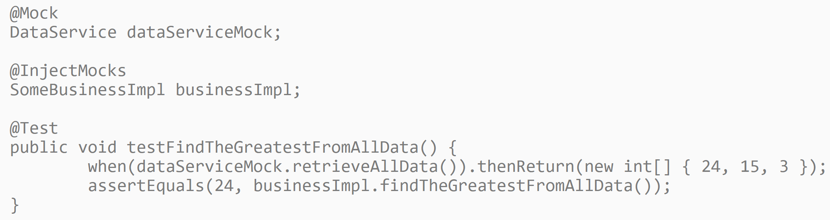
5 – Testing
Unit Test Example

Slide 67
Exercises

Slide 68
Microservices – Exercise 1
Key steps (refer Generali-4-Microservices-exercises Exercise 1 for details)
Build API specification using Swagger tools
Generate the server code using Swagger codegen
Study the project structure, e.g. API interfaces, models, etc.
Learn how to Implement the business logic
Test the API using Swagger UI

Slide 69
Microservices – Exercise 2
Key steps (refer Generali-4-Microservices-exercises Exercise 2 for details)
Base on Exercise 1, implement the real business logic
Develop persistence service
Implement the API and access the database
Learn how to test the APIs in Swagger UI

Slide 70
Microservices – Exercise 3
Key steps (refer Generali-4-Microservices-exercises Exercise 3 for details)
Base on Exercise 2, configure the security aspects
Develop the basic authentication protected APIs
Understand the configurations
Test the APIs using Postman

Slide 71
Summary
What is covered
Introduction
Microservices Architecture
Design considerations
Design strategies
Microservices testing
The Twelve Factor methodology
Steps to build the microservices

